Slide 1

Authentication Applications:
Kerberos, X.509 and Certificates
2003700691
REYHAN AYDOĞAN

Slide 2
Outline
Introduction to KERBEROS
How Kerberos works?
Comparison between version 4 and 5
Certificates
X.509 Directory Authentication Service
Conclusion

Slide 3
Introduction to Kerberos
An authentication service developed for Project Athena at MIT
Provides
  strong security on physically insecure network
  a centralized authentication server which authenticates
    Users to servers
    Servers to users
Relies on conventional encryption rather than public-key encryption

Slide 4
Why Kerberos is needed ?
Problem: Not trusted workstation to identify
their users correctly in an open distributed environment
3 Threats:
  Pretending to be another user from the workstation
  Sending request from the impersonated workstation
  Replay attack to gain service or disrupt operations

Slide 5
Why Kerberos is needed ? Cont.
Solution:
  Building elaborate authentication protocols at each server
  A centralized authentication server (Kerberos)

Slide 6
Requirements for KERBEROS
Secure:
  An opponent does not find it to be the weak link
Reliable:
  The system should be able to back up another
Transparent:
  An user should not be aware of authentication
Scalable:
  The system supports large number of clients and severs

Slide 7
Versions of KERBEROS
Two versions are in common use
  Version 4 is most widely used version
  Version 4 uses of DES
  Version 5 corrects some of the security deficiencies of Version 4
  Version 5 has been issued as a draft Internet Standard (RFC 1510)

Slide 8
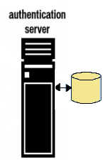


Kerberos Version 4: Dialog 1- Simple
Pc=password of client
1- IDc + Pc+IDv
2- Ticket
3- IDc +Ticket
kv=Secret Key between AS and V (Server)
Ticket=Ekv[IDc,ADc,IDv]

Slide 9

Kerberos Version 4 : Dialog 2-More Secure
ticketTGS=EKtgs[IDc,ADc,
IDtgs,TS1,LifeTime1 ]
Once per user logon session
1- IDc + IDtgs
Once per type of service
2- EKc [TicketTGS]
3- TicketTGS+IDc+IDv
4-TicketV

Slide 10
Kerberos Version 4 : Dialog 2
- More Secure Cont.
Once per service session
5- TicketV+ IDc
TicketV=EKv[IDc,ADc,IDv,Ts2,Lifetime2]

Slide 11
Kerberos: The Version 4 Authentication Dialog
Once per user logon session
KERBEROS
ticketTGS=EKtgs [Kc.tgs, IDc,ADc,IDtgs,TS2, LifeTime2 ]
1- IDc + IDtgs +TS1
2- EKc [Kc.tgs,IDtgs,Ts2,
Lifetime2,TicketTGS]

Slide 12
Kerberos: The Version 4 Authentication Dialog Cont.
Once per type of service
KERBEROS
ticketTGS=EKtgs [Kc.tgs,IDc,ADc,IDtgs, TS2, LifeTime2 ]
AuthenticatorC=EKc.tgs[IDc,ADc,TS3]
ticketV=EKV[Kc.v,IDc,ADc,IDv, TS4, LifeTime4 ]
3- TicketTGS + AuthenticatorC + IDv
4-EKc.tgs[ Kc.v,IDv,Ts4,Ticketv]

Slide 13
Kerberos: The Version 4 Authentication Dialog Cont.
Once per service session
5- TicketV+ AuthenticatorC
6- EKc.v[TS5+1]
TicketV=EKv [Kv.c, IDc, ADc, IDv, TS4, Lifetime4]
AuthenticatorC=EKc.v [IDc,ADc,TS5]

Slide 14
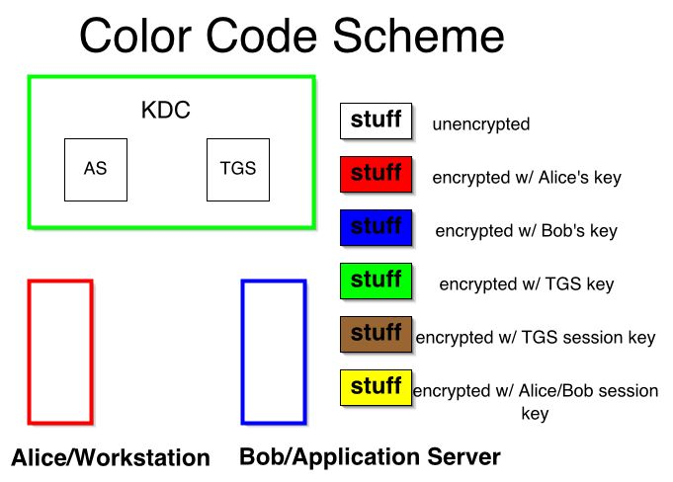
Overview of Kerberos: 1

Slide 15
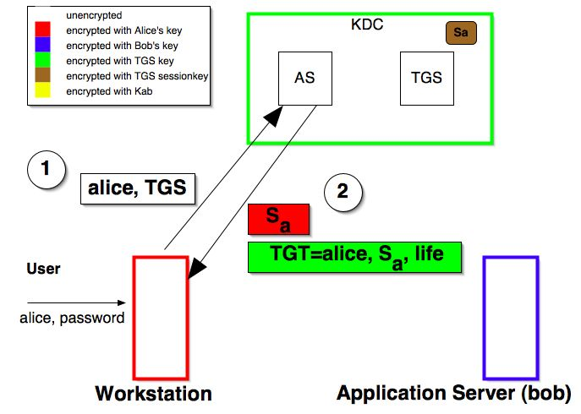
Overview of Kerberos: 2

Slide 16
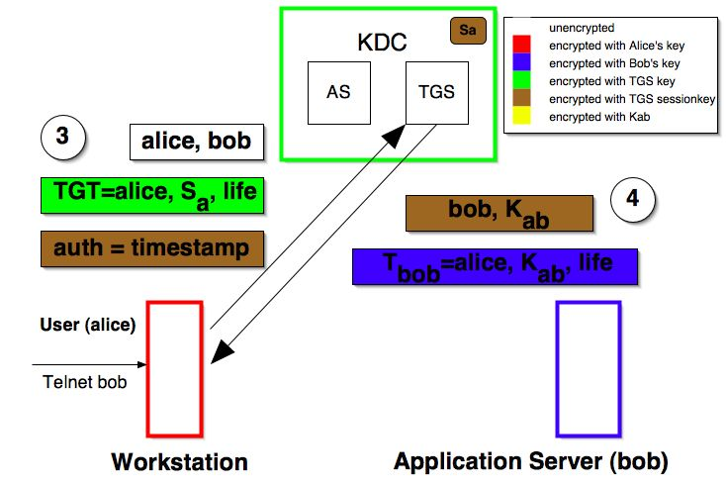
Overview of Kerberos: 3

Slide 17
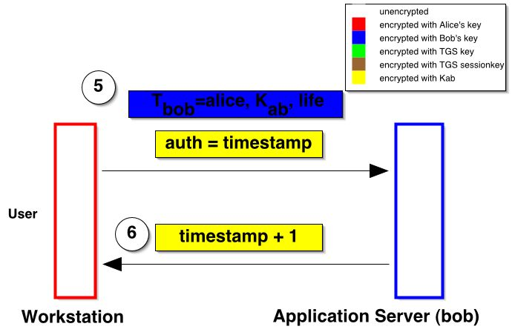
Overview of Kerberos: 4

Slide 18
Tickets:
Contains information which must be considered private to the user
Allows user to use a service or to access TGS
Reusable for a period of particular time
Used for distribution of keys securely

Slide 19
Authenticators
Proves the client’s identity
Proves that user knows the session key
Prevents replay attack
Used only once and has a very short life time
One authenticator is typically built per session of use of a service

Slide 20
Kerberos Realms
A single administrative domain includes:
  a Kerberos server
  a number of clients, all registered with server
  application servers, sharing keys with server
What will happen when users in one realm need access to service from other realms?:
  Kerberos provide inter-realm authentication

Slide 21
Inter-realm Authentication:
Kerberos server in each realm shares a secret key with other realms.
It requires
  Kerberos server in one realm should trust the one in other realm to authenticate its users
  The second also trusts the Kerberos server in the first realm
Problem: N*(N-1)/2 secure key exchange

Slide 22

Request for Service in another realm:
1-Request ticket for local TGS
2-Ticket for local TGS
3-Request ticket for remote TGS
7-request for remote service
4-Ticket for remote TGS
5-Request ticket for remote server
6-Ticket for remote server

Slide 23
KERBEROS Version 5 versus Version4
Environmental shortcomings of Version 4:
  Encryption system dependence: DES
  Internet protocol dependence
  Ticket lifetime
  Authentication forwarding
  Inter-realm authentication

Slide 24
KERBEROS Version 5 versus Version4
Technical deficiencies of Version 4:
  Double encryption
  Session Keys
  Password attack

Slide 25
New Elements in Kerberos Version 5
Realm
  Indicates realm of the user
Options
Times
  From: the desired start time for the ticket
  Till: the requested expiration time
  Rtime: requested renew-till time
Nonce
  A random value to assure the response is fresh

Slide 26
Kerberos Version 5 Message Exchange:1
To obtain ticket-granting ticket:
(1)C → AS : Options || IDc || Realmc || IDtgs ||Times ||
Nonce1
(2) AS → C : Realmc || IDc || Ticket tgs ||
EKc [ Kc,tgs || IDtgs || Times || Nonce1 ||| Realm tgs ]
Ticket tgs= EKtgs [ Flags || Kc,tgs || Realm c ||
IDc || ADc || Times]

Slide 27
Kerberos Version 5 Message Exchange:2
To obtain service-granting ticket :
(3)C → TGS : Options || IDv || Times || Nonce2 || Ticket tgs ║
Authenticator c
(4)TGS → C : Realmc || IDc || Ticket v || EK c,tgs [ Kc,v ║Times||
Nonce2 || IDv ║ Realm v]
Ticket tgs= EKtgs [ Flags || Kc,tgs || Realm c || IDc || ADc ||
Times]
Ticket v : EK v [Kc,,v ║ Realmc || IDc ║ ADc ║ Times ]
Authenticator c : EK c,tgs [IDc ║ Realmc ║ TS1]

Slide 28
Kerberos Version 5 Message Exchange:3
To obtain service
(5) C → S : Options || Ticket v|| Authenticator c
(6) S → C : EK c,v [TS2|| Subkey || Seq# ]
Ticket v : EK v [Flags || Kc,v || Realmc ||
IDc || ADc || Times ]
Authenticator c : EK c,v [IDc || Realmc ||
TS2 || Subkey|| Seq# ]

Slide 29
Kerberos : Strengths
User's passwords are never sent across the network, encrypted or in plain text
Secret keys are only passed across the network in encrypted form
Client and server systems mutually authenticate
It limits the duration of their users' authentication.
Authentications are reusable and durable
Kerberos has been scrutinized by many of the top programmers, cryptologists and security experts in the industry

Slide 30
Certificate:
Electronic counterparts to driver licenses, passports
Verifies authenticity of the public key
Prevents impersonation
Enables individuals and organizations to secure business and personal transactions

Slide 31
What a certificate includes:
Name of Entity being Certified
Public Key
Name of Certificate Authority
Serial Number
Expiration Date
Digital signature of the issuer
Other information (optional)

Slide 32
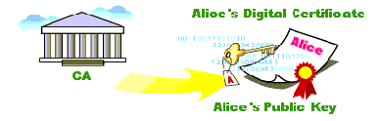
Certificate Authorities:
Trusted entity which issue and manage certificates for a population of public-private key-pair holders.
A digital certificate is issued by a CA and is signed with CA’s private key.

Slide 33
Who are the Certificate Authorities?
VeriSign
GTE CyberTrust
Entrust
IBM
CertCo
USPS / Cylink

Slide 34
Certificate Issuance Process:
Generate public/private key pair
Sends public key to CA
Proves identity to CA - verify
CA signs and issues certificate
CA e-mails certificate or Requestor retrieves certificate from secure websites
Requestor uses certificate to demonstrate legitimacy of their public key

Slide 35
Types of Digital Certificates
E-Mail Certificates
Browser Certificates
Server (SSL) Certificates
Software Signing Certificates

Slide 36
Potential security holes:
Was the user really identified?
Security of the private key
Can the Certificate Authority be trusted?
Names are not unique

Slide 37
X.509 Directory Authentication Service
CCITT recommendation defining a directory service
Defines a framework for the authentication services
The X.500 directory serving as a repository of public-key certificates
Defines alternative authentication protocols

Slide 38
X.509 Certificate format
Version
Serial number
Algorithm Parameters
Issuer
Not before Not after
Subject
Algorithm Parameter Key
Signature
Notation to define a certificate:
Algorithm
identifier
CA<<A>>=CA{V,SN,AI,CA,Ta,A,Ap}
where
Y<<X>>= the certificate of user X issued by certification authority Y
Y{I}=the signing of I by Y. It consists of I with an enciphered hash code appended.
Period of
validity
Subject’s
public key

Slide 39
Securely Obtain a Public Key
Scenario:
  A has obtain a certificate from the CA X1
  B has obtain a certificate from the CA X2
  A can read the B’s certificate but cannot verify it.
Solution: X1<<X2> X2<<B>>
  A obtain the certificate of X2 signed by X1 from directory. →obtain X2’s public key
  A goes back to directory and obtain the certificate of B signed by X2.
  →obtain B’s public key securely

Slide 40
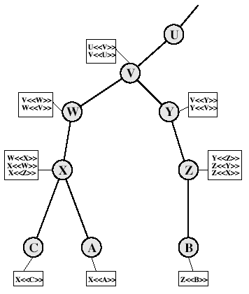
X.509 CA Hierarchy
A acquires B certificate using chain:
X<<W>>W<<V>>V<<Y>>Y<<Z>> Z<<B>>
B acquires A certificate using chain:
Z<<Y>>Y<<V>>V<<W>>W<<X>> X<<A>>

Slide 41
Authentication Procedures:
Three alternative authentication procedures:
  One-Way Authentication
  Two-Way Authentication
  Three-Way Authentication
All use public-key signatures

Slide 42
One-Way Authentication:
1 message ( A->B) used to establish
  the identity of A and that message is from A
  message was intended for B
  integrity & originality of message
A
B
1-A {ta,ra,B,sgnData,KUb[Kab]}
Ta-timestamp rA=nonce B =identity
sgnData=signed with A’s private key

Slide 43
Two-Way Authentication
2 messages (A->B, B->A) which also establishes in addition:
  the identity of B and that reply is from B
  that reply is intended for A
  integrity & originality of reply
A
1-A {ta,ra,B,sgnData,KUb[Kab]}
B
2-B {tb,rb,A,sgnData,KUa[Kab]}

Slide 44
Three-Way Authentication
3 messages (A->B, B->A, A->B) which enables above authentication without synchronized clocks
1- A {ta,ra,B,sgnData,KUb[Kab]}
A
B
2 -B {tb,rb,A,sgnData,KUa[Kab]}
3- A{rb}

Slide 45
Conclusion
Kerberos is an authentication service using convention encryption
Certificates is the proof of the identity
X.509 defines alternative authentication protocols

Slide 46
THANKS FOR LISTENING
ANY QUESTION?

Slide 47
REFERENCES:
Stallings, William, “Network and Internetwork Security Principles and Practice ”,Prentice Hall, New Jersey,1995
http://web.mit.edu/kerberos/www/
www.upenn.edu/computing/provider/ orientation/2003-03-Kerberos.ppt
http://www.its.monash.edu.au/security/certs/theory/trusting_certs.html
http://www.comodogroup.com/support/learning/digital_certificate/
https://digitalid.verisign.com/client/help/introID.htm#1
www.drgsf.com/IntroDigitalCerts7-98.pdf

